Slide 1
Closer To Fine?
Moving toward a unified system

Slide 2



Slide 3
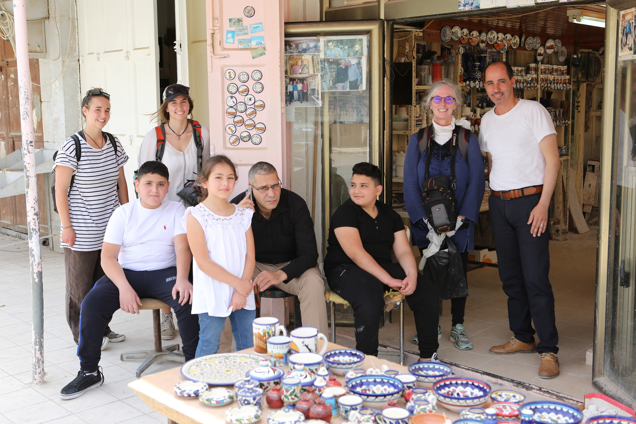

Slide 4



Slide 5
New GIT Package with An Najah HTC Code:
https://github.com/taktse/An-Najah-HTC
Includes:
Cobbler Utilities:
MAC Address
Disk IDs
AddNewHost
Puppet Utilities
Client and Server puppet.conf
hiera.yaml
node.py
Puppet Modules from Colorado Cluster
Preliminary SSH host management software
KVM Utiities
Please create a personal GITHUB account so I can add you as a collaborator on this project.
Brief GIT Tutorial

Slide 6
OpenIPA Installed on htc180
https://www.freeipa.org/page/Main_Page
FreeIPA is an integrated Identity and Authentication solution for Linux/UNIX networked environments. A FreeIPA server provides centralized authentication, authorization and account information by storing data about user, groups, hosts and other objects necessary to manage the security aspects of a network of computers.
There is a Google doc that covers this installation.
Class 19 - Cluster Account Creation and Management
Need to create Puppet module for client installation
Work started for putting home directory mounting into autofs
Documentation still in progress.

Slide 7
To Do:
Reinstall all machine
Mount /home from server RAID
Install Hadoop
Install HTCondor

